Slide 1

Thinking Large Language Model Project Report
By 王志杰-zhijie-19,段元恒-jerry-20,盛一诺-Ethan-22,王泽臻-Jason-23,刘姜楠-Tim-21
This report provides a detailed introduction to the “Thinking Large Language Model" project, including its background, process, and evaluation. Inspired by DeepSeek R1, this project replicates the Open R1 project, aiming to develop a language model with powerful reasoning capabilities in mathematical tasks. Through a two-stage optimization process, we combined fine-tuning techniques and reinforcement learning to improve the model's efficiency and performance.

Slide 2

Research Background and Project Objectives
Application of Large Language Models (LLMs) in Mathematical Reasoning
1
The application of large-scale language models in solving mathematical problems has become an increasingly popular research focus.
2
Qwen2.5-Math Model
The Qwen LM team has developed a model focused on mathematical reasoning, which can solve complex algebra, geometry, and calculus problems.
Project Objectives
3
Through local deployment optimization and reinforcement learning training, we aim to enhance the reasoning capabilities of Qwen2.5-Math in mathematical tasks.
1
Improve the mathematical problem-solving ability of Qwen2.5-Math
2
Reduce computational costs and improve reasoning speed
3
Further improve performance using Supervised Fine-Tuning (SFT) and Reward-Guided Policy Optimization (GRPO)

Slide 3

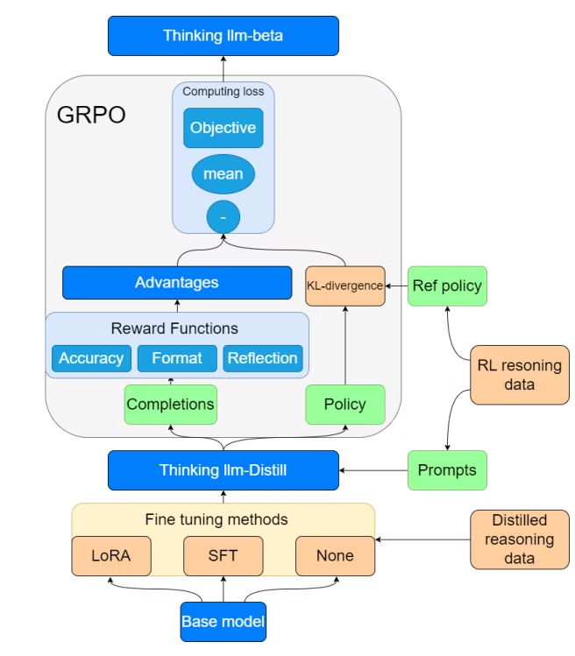
Project Workflow
1
Basic model deployment
2
Supervised Fine-tuning (SFT)
Use the pre-trained Qwen2.5-Math model to solve the deployment problem.
Fine-tune the model to improve mathematical reasoning accuracy.
3
GRPO reinforcement learning
4
Testing and Evaluation
Test the performance of the optimized model to ensure its superior performance in mathematical tasks.
Improve the model's reasoning strategy and performance through reinforcement learning.

Slide 4

Base Model Deployment
1
Computing resources
2
Mathematical reasoning ability
Qwen2.5-Math pre-trained model can significantly save computing resources and avoid training from scratch.
The model performs well on mathematical tasks, especially on datasets such as MATH-500.
3
Compatibility
Compatible with tools such as Hugging Face and DeepSpeed, making deployment easy.
1
Computing resource optimization
4-bit quantization: Reduces video memory usage and ensures that the 7B version can run on a GPU with 24GB video memory.
DeepSpeed ​​& vLLM distributed reasoning: Distributed reasoning technology improves reasoning efficiency.
Flash Attention accelerates reasoning: Optimizes model reasoning speed and reduces computing overhead.

Slide 5
Full and Partial Fine-Tuning
1
Full Fine-Tuning
2
Partial Fine-Tuning
Refers to training and adjusting all the parameters of the entire pre-trained model to adapt to the data of a specific task or domain.
Refers to training and adjusting only a small portion of the parameters of a pre-trained model, or adapting to specific tasks by adding a few extra parameters.

Slide 6
The Difference Between Full Fine-Tuning and Partial Fine-Tuning
The difference
Full fine-tuning
Partial fine-tuning
1.Parameter update range
Update all parameters of the model
Update some parameters or add a few parameters.
2.Computational resource requirements
Very high
Medium-low or low
3.Training time
Usually very long
Relatively short
4.Fine-tuning effect
Relatively obvious
Relatively small

Slide 7
SFT supervised fine-tuning
method
describe
SFT (Supervised Fine-tuning)
The base model is fine-tuned using standard supervised learning to improve its accuracy in math problem solving.
LoRA (Low Rank Adaptation)
This fine-tuning method improves the fine-tuning efficiency by reducing computational complexity and the number of parameters.
No fine-tuning (None)
In some cases, the base model is used directly for inference without additional fine-tuning.

Slide 8
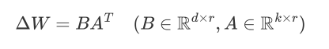


The Principle of LoRA and SFT
LoRA’s core idea lies in decomposing the original parameter matrix through the product of low-rank matrices, thereby reducing the number of adjustable parameters.

Slide 9
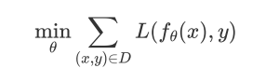
The Principle of LoRA and SFT
SFT employs an end-to-end full parameter update method. Its optimization objective equation can be expressed as:

Slide 10
LoRA specific operation:
•1.Preprocess the dataset
•1.1Download the grade-school-math-master and OpenR1-Math-220k (default) datasets.
•1.2 Clean the answer fields in the dataset; format each sample in the dataset into the input format for the Qwen large language model.
•1.3Save the preprocessed dataset.
•2.LoRA Training
•2.1Load the dataset and model.
•2.2Configure LoRA parameters and apply them to the model.
•2.3 Start training and save the results. The final results are obtained through multiple adjustments of the training parameters.

Slide 11
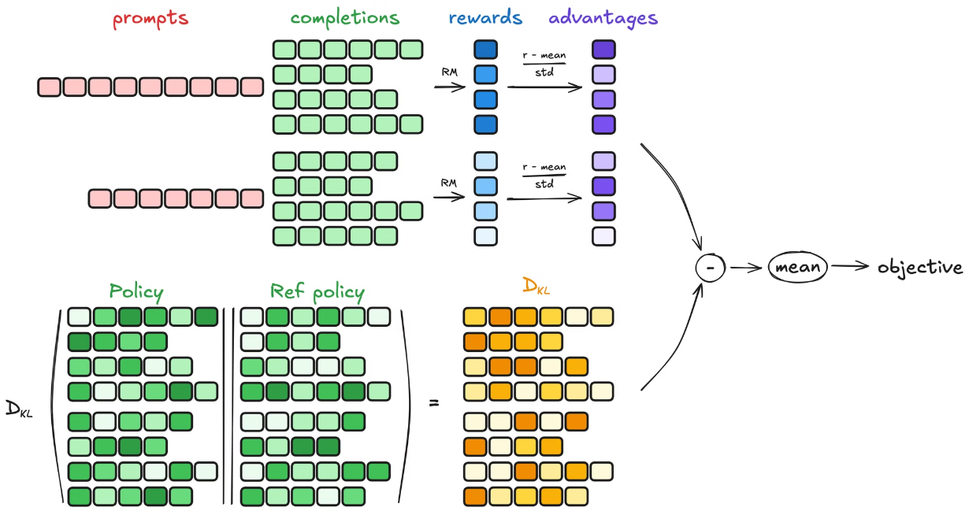
GRPO Process

Slide 12
GRPO reinforcement learning optimization
KL-Divergence calculation
The policy of the reference dataset is used to calculate KL-Divergence with the existing policy to ensure that the optimized model behavior is consistent with the baseline model.
Starting Model
Start with "Thinking LLM-Distill", a pre-trained model used for the reinforcement learning phase of training.
1
2
3
4
Generation and reward calculation
Loss calculation and optimization
Use the prompts in the dataset to generate model answers and calculate the advantages of the answers through reward functions.
By calculating advantages and KL-Divergence, we get the loss value and optimize the model.
1
Accuracy Reward
2
Format Reward
Rewards are given based on the accuracy of the answer.
Rewards will be given based on the format and clarity of the answer.
3
Reflection Reward
Rewards are given based on the model's ability to self-reflect and improve.

Slide 13
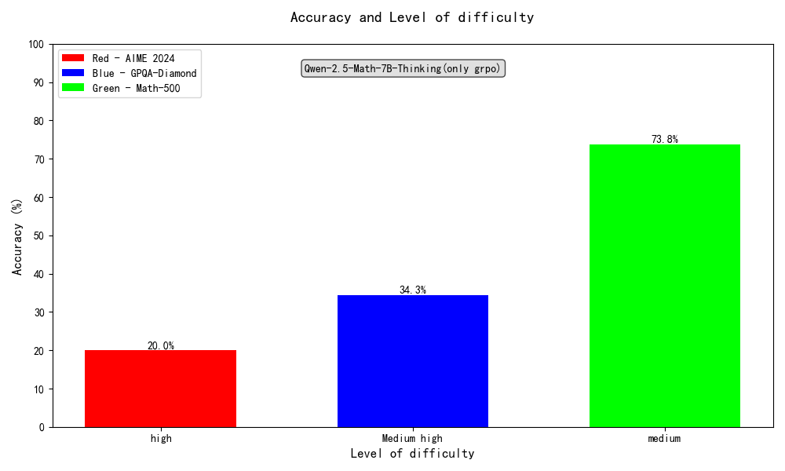
Dataset Introduction
1.aime24:
American Invitational Mathematics Examination in 2024
2.math_500:
MATH500 is a carefully selected subset of 500 problems from the extensive MATH dataset
3.GPQA:Diamond:
This dataset is a subset of the Graduate-Level Google-Proof Q&A Benchmark (GPQA), containing 198 challenging questions in biology, physics, and chemistry.

Slide 14
Experimental Results Overview
Model
MATH-500
gpqa:diamond
AIME_2024
Qwen2.5-Math-1.5B
45.4
27.27
10.00
Qwen2.5-Math-7B
58.6
26.26
16.67
Qwen2.5-Math-1.5B-sft
58.2
35.35
3.33
Qwen2.5-Math-1.5B-Math-LoRA-Merged
42.2
30.81
6.67
Qwen-2.5-Math-1.5B-Thinking(sft+grpo)
50.0
26.26
13.33
Qwen-2.5-Math-1.5B-Thinking(only grpo)
54.6
25.76
13.33
Qwen2.5-Math-7B-sft
66.2
37.37
16.67
Qwen-2.5-Math-7B-Thinking(sft+grpo)
57.6
41.41
16.67
Qwen-2.5-Math-7B-Thinking(only grpo)
73.8
34.34
20.00

Slide 15
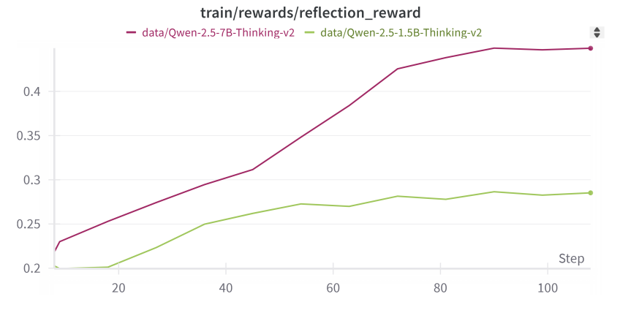
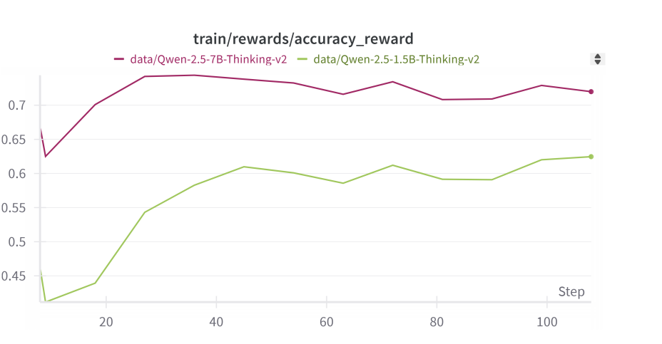
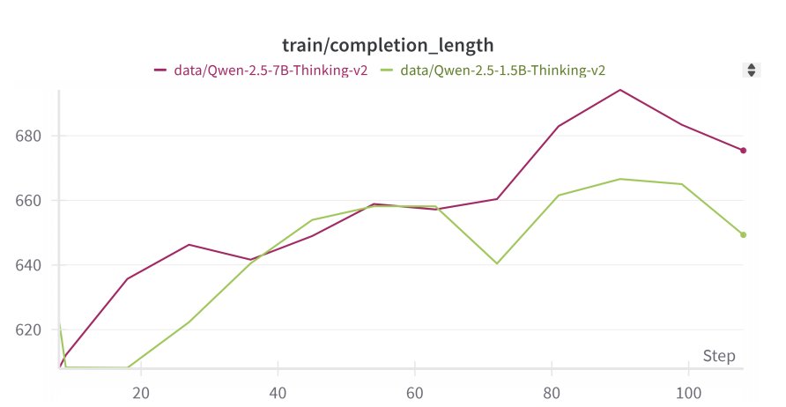
Analysis of GRPO training process and reward mechanism

Slide 16
Conclusion
Baseline Comparison and GRPO Effectiveness
GRPO models outperform Qwen-Math baseline.
Parameter-Efficient vs. Full Fine-tuning
1
LoRA Merging Issues
2
Full Fine-tuning Superiority
LoRA models underperform on test sets.
SFT models beat LoRA variants.
Data Scarcity Challenges
GRPO performance drops when applied to fine-tuned models.
Reflection Reward Validation
Increased completion length shows reflection reward works.

Slide 17
Experience summary and future research directions
1
Experience summary
2
Future research directions
Computing resource optimization: successfully solved the problem of video memory overflow, and improved the reasoning efficiency by using 4-bit quantization and distributed reasoning.
Expand the data set size and improve the generalization ability of the model.
Fine-tuning and reinforcement learning optimization: the combination of the two significantly improved the performance of the model in mathematical reasoning tasks, especially in difficult mathematical problems.
Optimize the use of computing resources to further improve the inference speed and efficiency.

Slide 18
Acknowledgements and References
Acknowledgements
References
Open R1: A fully open reproduction of DeepSeek-R1 https://github.com/huggingface/open-r1
7B Model and 8K Examples: Emerging Reasoning with Reinforcement Learning is Both Effective and Efficient https://hkust-nlp.notion.site/simplerl-reason
DeepSeek-R1: Incentivizing Reasoning Capability in LLMs via Reinforcement Learning https://arxiv.org/abs/2501.12948
Qwen2 technical report [2407.10671] Qwen2 Technical Report
LLM.int4: 4-bit Quantization for Large Language Models. arXiv. https://arxiv.org/abs/2212.09720
DeepSpeed: Accelerating Transformer Training and Inference. Microsoft Research. https://arxiv.org/abs/2007.00072
FlashAttention: Fast and Memory-Efficient Attention for Transformers. NeurIPS. https://arxiv.org/abs/2205.14135
open-r1/OpenR1-Math-220k https://huggingface.co/datasets/open-r1/OpenR1-Math-220k
DigitalLearningGmbH/MATH-lighteval https://huggingface.co/datasets/DigitalLearningGmbH/MATH-lighteval
Cognitive Behaviors that Enable Self-Improving Reasoners, or, Four Habits of Highly Effective STaRs https://arxiv.org/abs/2503.01307
LoRA: Low-Rank Adaptation of Large Language Models [2106.09685] LoRA: Low-Rank Adaptation of Large Language Models
LLM.int8(): 8-bit Matrix Multiplication for Transformers at Scale [2208.07339] LLM.int8(): 8-bit Matrix Multiplication for Transformers at Scale
Exploring the Limits of Transfer Learning with a Unified Text-to-Text Transformer [1910.10683] Exploring the Limits of Transfer Learning with a Unified Text-to-Text Transformer

